Slide 1
Lecture #1 23/03/26
TOPIC 1: INTRODUCTION TO SOCIOLOGY OF EDUCATION
1.1 Outcomes: Upon completion of this topic students can:
Define the term sociology and sociology of education.
List the differences between sociology and the other social sciences.
State the development of sociology.
Identify and name the characteristics of sociology.
Identify and list the different research methods used by sociologists.
Explain the different theoretical paradigms used by sociologists.

Slide 2
1.2 Introduction
Welcome to lecture one on sociology of education!
This lecture covers the;
definition of sociology and sociology of education.
differences between sociology and the other social sciences.
development of sociology.
characteristics of sociology.
different research methods used by sociologists.
theoretical paradigms used by sociologists.

Slide 3
1.3 Definition of sociology and sociology of education
1.3.1 Sociology;
Latin ‘socius’ (companion) or ‘societus’ (society) and the Greek ‘logos’ (the study of). Literally means the study of the processes of companionship or social relations.
systematic study of human, social behavior, and institutions.
analysis of the structure of social relationships.
study of people and their environment in their relationship with each other.
the study of the history and nature of human society.
scientific and systematic study of social behaviours and people in groups.
However, no definition is entirely satisfactory because of the diversity of perspectives.
(Dictionary of Sociology, 1988; Nobbs, Hine & Flemming, 1979; Oxford English Dictionary, n.d.)

Slide 4
1.3.2 sociology of education;
study of the relationship between education and society
study of how public institutions and individual experiences affect education and its outcomes.
study about the work and progress of school and its concerned members, teachers towards the development of society.
Literally, sociology of education is the specific study of educations’ interactions on society and vice-versa. How both shape each other.

Slide 5
1.4 Sociology and the Social Sciences
Sociology is a discipline of social science.
Other disciplines of social science includes political science, psychology, history, anthropology and economics.
Other branches of social sciences are focused in a particular area, but sociology looks at everything from a broader perspective. Eg; political science studies State and Government only whereas sociology studies all social institutions.

Slide 6
Differences between sociology and social sciences
Sociology | Social Science
specific study of human society, social interactions, and institutions. | an umbrella term for all disciplines that study human aspects of the world.
narrower; focuses on social behavior and structures (like family, religion, or class, school). | broader; includes sociology, psychology, economics, history, and political science.
understand how society functions and how individuals are shaped by groups. | understand the complexity of human life through various specialized lenses.
specific branch or subset. | entire category or field of study.

Slide 7
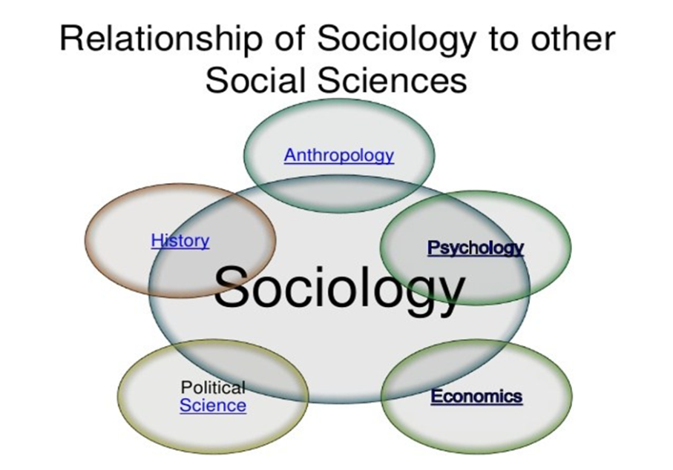

Slide 8
1.5 The Development of Sociology
Sociology- first developed by Augustine Comte, a French man in 1838.
He put two Latin words socius (companion or associate) and the Greek term logia (study of speech).
Comte believed that;
sociology could unify other sciences and improve society.
science of sociology should be based on systematic observation and classification not on authority and speculation.

Slide 9
Comte believed societies developed in three stages:
Theological stage- people took religious views of society.
2. Metaphysical stage- people understood society as natural (not supernatural).
3. Scientific or positivist stage- society would be governed by reliable knowledge.

Slide 10
1.6 The Characteristics of Sociology
Four (4) characteristics of sociology:
a) Empirical - based upon things observed and intelligent reasoning, not supernatural phenomena.
b)Theoretical - observations made are summarized in a logical way as part of a theory about the nature of society.
c) Non-ethical (objective) - observations are conducted without bias.
d) Cumulative - different sociological theories constructed out of other theories which have been modified or corrected in the light of fresh evidence.

Slide 11
1.7 The Methods of Sociology.
Sociologists do research using different research methods. These methods include:
observations
theories
concepts
analytical models
experiments.
However, the four most widely used methods are:
(a) experiments - starts with a hypothesis.
(b) surveys - researcher obtains responses to a series of items or questions.
(c) participant observation - direct observation of a social setting for an extended period of time.
(d) secondary analysis - makes use of available data.

Slide 12
1.8 The Three Sociological Theories/Paradigms
Three main paradigms used by sociologist are;
1.structural-functional paradigm - explains how various structures are integrated and how each function to promote the stable operation of society as a whole.
2.social-conflict paradigm- explores patterns of social inequality that generate conflict within a society and promote social change. This theory tends to minimize the extent of social integration and social stability.
3.symbolic –interactionism paradigm - studies patterns of individual interaction within specific situations. In this theory, society is seen as highly variable and constantly changing.

Slide 13
Sociological Paradigms | Level of Analysis | Focus
Functionalism/ Structural Functionalism Theory | Macro | The way each part of society functions together to contribute to the whole society.
Conflict Theory | Macro | The way inequalities contribute to social differences and perpetuate differences in power .
Symbolic Interactionism Theory | Micro | On-to-one interactions and communications.

Slide 14
Summary
Sociology is a field of social sciences that focuses the study of society and human interactions in different social institutions.
Education is a social institution and a social activity.
Thus, sociology of education is the specific study of educations’ interactions on society and vice-versa. How both shape each other.
Note: Refer to tutorial questions in the course guide. Page 30

Slide 15
1.9 Tutorial Questions
Is Sociology really a Science? Explain why or why not?
Is Sociology just a common sense? Explain why or why not?
Do Sociologists always agree with each other? Explain why or why not?
Explain in point form why you think Sociology is important and the benefits it can bring?
What qualities should a successful student in sociology have?
Ms Niningi

