Slide 1
Lecture #4
TOPIC 4: SOCIAL CHANGE, DEVELOPMENT AND EDUCATION
3.1 Outcomes: Upon completion of this topic students can:
Define the terms social change and development.
Explain the general characteristics of social change.
Explain the general characteristics of the process of social change.
State and explain the theories of development.

Slide 2
4.2 Introduction
Welcome to lecture four on social change, development and education!
This lecture covers the;
terms social change and development.
general characteristics of social change.
general characteristics of the process of social change
theories of development

Slide 3
4.3 Social Change
Social change refers to significant shifts in social structures, cultural norms, and institutions, often driven by technological advancements, economic shifts, political movements, or environmental factors.
It may also be defined as the transformation of culture and social institutions over time that is reflected in the life patterns of individuals.

Slide 4
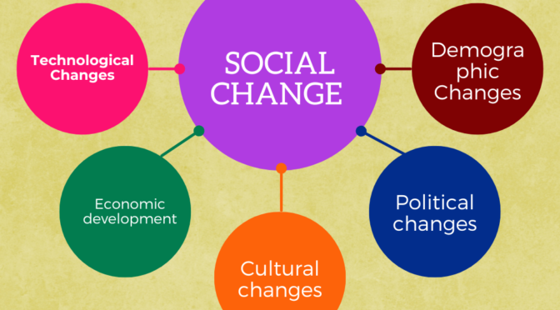
The diagram below shows the social change in different areas.

Slide 5
The process of social change has four general characteristics.
1. Social change is universal but variable. However, it is important to remember they do not always change at the same rate e.g. hunter-gatherer societies change more slowly than industrialised societies.
2. Social Change is both intentional and unplanned. For example, industrialised societies often encourage change but fail to see the consequences e.g. dominating influence of cars and trucks.
3. Social change is often controversial. For example, some see nuclear power as a cheap inexhaustible supply of power while others say the disaster of Chernobyl shows its massive human dangers.
4. Social change differs in duration and consequences. Some social changes may be of passing importance e.g. “pop” groups while others have massive long-term effects e.g. TV and computers.

Slide 6
Causes of Social Change
invention and discovery within a society e.g. space flight and medical advances.
cultural diffusion from one society to another e.g. American computer technology is rapidly bringing change to developing countries.
social structure i.e. tensions and conflicts within society itself.
inequalities in class, race and gender.
Ideas can also encourage or inhibit social change e.g. personal charisma of leaders like Mandela or emergence of social movements e.g. gay and lesbian rights movements.
natural environment and population dynamics contribute to social change e.g. depleted forests and use of fertilizers and chemicals.

Slide 7
Modernity as Social Change
Modernity-patterns of social organisation linked to industrialisation, and it is one of the central ideas in the study of social change.
Philosopher's Views on Modernity as Social Change
Berger-general characteristics of modernity are the weakening of small traditional communities, the expansion of personal choice, increasing diversity in patterns of belief, and a keener awareness of time, especially the future
Toennies - loss of community and emphasis on individuality.
Durkheim-integration of modern society through specialisation.
Weber - rise of modernity as the replacement of the tractional by the rational.
Max-triumph of capitalism which he considered was unstable and would lead to inevitable social conflict.

Slide 8
Many people think that modernity inevitably leads to social progress. This simplified view overlooks the fact that social changes perceived as good from one point of view may be perceived as bad from another e.g. nuclear families are usually thought of as good in modern terms, but traditional societies support the ideals of extended families.
Social change is highly complex- from virtually any point of view; modernity has produced consequences that are good and bad e.g. technology.
Reflection? What are some social changes in technology that are good and bad in PNG?

Slide 9
4.3 Development
Development is the process of growth or changing from one condition to another. It is a continuous process whereby an individual, community or nation grows or improves in some ways.
A good comparison can be made with a seed, which germinates flowers and eventually becomes a fully developed plant.

Slide 10
Words that have similar meaning to development;
growth
progress
positive change
advancement
evolution
Development is the notion of change and evolution in individuals and societies which have innate biological, psychological and social capacities which can be evaluated in terms of their actualisations i.e. development is any change which promotes these dimensions or potential (Fagerlind & Saha,1989).

Slide 11
Measurements of Development
measured purely using economic criteria i.e. using GDP and GNP per capita.
Former development is obtained by dividing the monetary value of all goods and services produced in a country by its total population.
PNG does quite well with about $800/capita, making it a middle-income country.
However, recently an increasing number of definitions, often involving culture, social well-being and political rights, have been suggested as alternatives because they emphasis ‘quality of life’ in contrast to just ‘standard of living’.

Slide 12
As a result of these criticisms, the UN developed in the 1990’s the Human Development Index (HDI), which gives every country a score between 0 and 1, based on its citizen’s longevity, education and income.
Other factors sometimes used to measure development include human rights, freedom, prevalence of diseases, density of communication networks, circulation of newspapers, number of cars, TV’s and telephones.

Slide 13
Human Development paradigm also emphasises that there are four essential components.
Productivity – People must be enabled to increase their productivity and to participate fully in the process of income generation and remunerative employment i.e. the economy.
Equity– People must have access to equal opportunities. All barriers to economic and political opportunities must be eliminated so that people can participate in and benefit from these opportunities.
Sustainability – Access to opportunities must be ensured for present and future generations. All forms of physical, human and environmental capital should be replenished.
Empowerment- Development must be by the people, not only for them. People must participate fully in the decisions and processes that shape their lives.

Slide 14
4.4 Theories of development
Structural – Functionalism –society is seen as a system of interrelated parts e.g. religion, education and economy which are all striving for equilibrium or harmony between themselves.
Modernisation theory- This is an approach to global change maintaining that traditional societies will gradually be transformed by industrialisation to resemble developed countries. It suggests that all societies should strive to be modern and industrialised. It characterises modernisation as revolutionary, complex, systematic, global, irreversible and progressive.

Slide 15
Human Capital theory – This theory states that the most efficient path to the national development of any society lies in the improvement of its population i.e. its human capital and that education is an integral productive investment that will lead to economic growth.
Marxist theory –society is divided into the exploiting (bourgeoisie) and exploited who are all in conflict. He believed society progressed from primitive, through slavery, feudalism, capitalism, socialism and finally communism through revolution. It has been criticised for being too aggressive, simplistic and essentially out-of-date.

Slide 16
Dependency theory – This theory considers development and underdevelopment within and between societies are inversely related i.e. the development of central (metropole) societies causes the underdevelopment of peripheral (satellite) societies. It therefore focuses on the extent to which poor countries are dependent on the rich. While in strong disagreement with modernisation theory, it can be criticised for being too simplistic, absolving governments of their responsibilities and disengaging from western countries that want to help. This could mean they end up worse than they already are.

Slide 17
Liberation theory – This postulate underdeveloped societies are oppressed by the power holders who control all resources and that main remedy for overcoming this oppression lies in education of the oppressed to be aware of their condition. In this theory, education, believed to bring liberation and then development.

Slide 18
4.5 Education
Simply refers to transmission of knowledge, skills and attitude from one person to another for development of character traits.
Education plays a crucial role in both change and development by equipping individuals with knowledge, skills, and critical thinking abilities necessary for societal progress. It fosters social mobility, reduces inequalities, and promotes innovation, making it a key driver of modernization and transformation. Together, these elements contribute to the continuous evolution of societies, influencing how people interact, work, and improve their quality of life.

Slide 19
Tutorial Questions
What is the difference between social change and development?
What are the general characteristics of social change?
What are the general characteristics of the process of social change?
What are the theories of development?

